Slide 1
Statistical Resources for Chapman University Researchers
Joni Ricks-Oddie, PhD MPH
Director, UCI Center for Statistical Consulting | Department of Statistics Director, Biostatistics, Epidemiology & Research Design Unit | Institute for Clinical and Translation Science (ICTS)
University of California, Irvine

Slide 2
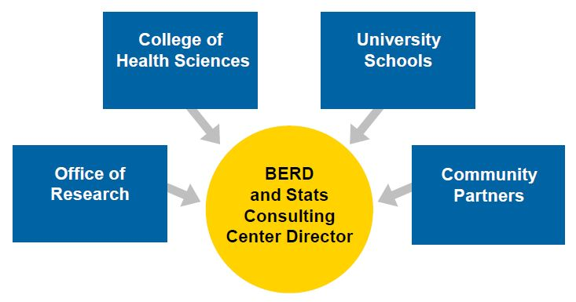
Who am I?

Slide 3
Why I am here?
To help!
Our goals with the UCI community:
Promote High Quality Research and competitive proposal development
Provide High Quality Statistical Support
Partner with researchers and research groups
We are extending those goals to our community partners like Chapman University
Chapman University Office of Research recognizes the gap and appreciates the need for statistical support

Slide 4
New Partnership – What is available to you!
Agreement between Chapman University and UCI (CSC and ICTS/BERD)
Access to the statisticians in both groups
Ability to make website meeting/consultations requests
Access to ICTS/BERD “Drop-In” consulting hours at UCI Main Campus in Irvine AND UCI Medical Center In Orange
Same internal rates ($80) as UCI affiliated faculty, staff and students
Opportunity to include CSC and ICTS/BERD statisticians on grant submissions (budget or sub-award)

Slide 5
Our services provide a holistic approach
Provide assistance at all stages of project development from study design through final publication.
Grant proposal preparation
Study design
Planning and conducting statistical analysis,
Power and sample size calculations
Interpretation of results
Manuscript/poster/abstract review and preparation
Response to reviewers
IRB applications,
Training in the use of statistical software
Research database design

Slide 6
Free and Fee
FREE
FEE
1st hour of consultation on any new project
Drop-In Consulting Sessions
Grant Submission Support
CSC and/or ICTS/BERD staff including in grant as budget or sub-award (% FTE)
Study Design
Power Analysis/Sample Size
Statistical Methods Planning and write-up
Consultation beyond the first hour on any project outside of Grant Submission Support
Study design to reviewer response
Grant preparation if we are not included in the grant

Slide 7
https://statconsulting.ics.uci.edu/chapman-researchers/

Slide 8
How to make a request?
https://statconsulting.ics.uci.edu/request-consultation/
Email gets sent to you and us
We typically follow-up in no more then 2-3 business days
Set-up an initial in-person or phone meeting

Slide 9
What to know (and think about) before we meet?
1st hour is free
Cost depends on the type(s) of assistance needed
Bring/Send any pertinent information related to your project
Expect a dialogue and for the statisticians to ask probing question
Be prepared to answer specific questions reading your project
Research question/aims/hypotheses
Data collection methods or status of collected data
Current or anticipated study design
Previous/related research
Timeline!
Authorship expectations

Slide 10
How we work?
Consultation Request
Initial Meeting
Scope of Work Drafted
Assigned to Statistician
Collaboration
Begins

Slide 11
FAQ
Do you have a set of Standard Operating Procedures?
Do you have similar relationship like this with other universities?
I am interested in getting trained to use statistical software is that something you could help with?
My research group need to learn how to do a specific type of analysis. Could you teach us how to do that?
I need a statistician to be part of a grant? Do you have someone who could help?
Notes:
Daniel Tomaszewski Pharm.D., Ph.D. – NIH RO3 Assistant Professor of Pharmacy Administration
Harry and Diane Rinker Health Science Campus
Provide statistical support, including power/sample size consideration, as well as data analysis and interpretation for the project.
PROVIDED BUDGET ESTIMATE AND los
Mary K. Fagan, PhD Communication Sciences and Disorders Crean College of Health and Behavioral Sciences
-PROVIDED BUDGET ESTIMATE AND los
- CONSULTATION OF SAP AND REPSONSE TO GRANT REVIEWER COMMENTS

Slide 12
Questions
Joni Ricks-Oddie, PhD MPH
jricksod@uci.edu

